Slide 1
Organization Strategy and Project Selection
(Ch. 2 – T1)
M K Hamirwasia
WILPD

Slide 2
AE ZG523/ES ZG523/DE ZG523/MM ZG523/POM ZG523-Merged
Project Management
Second Semester 2024-25
Lecture No. 3

Slide 3
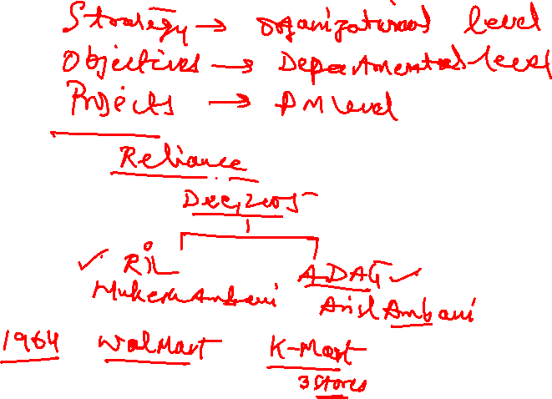

Slide 4
Strategy
Strategy – a plan of action to achieve a long-term or overall aim.
Eg. Economic strategy, military strategy
Strategy is the direction and scope of an organization over the long-term, which achieves advantage for the organization through its configuration of resources within a challenging environment to meet the needs of markets and to fulfil stakeholder expectations.

Slide 5
Organization Strategy
Importance of Strategic Planning
Aligning projects with the strategic goals of the Org’n is crucial for project success, esp. in today’s economic climate which is marked by rapid changes in technology, global competition and financial uncertainty.
Ensuring a strong link b/n strategy and projects is crucial to success.
More difficult to create and maintain this strong link in larger and more diverse organizations. Lack of a process that clearly aligns project selection to the strategic plan results in poor utilization of the Orgn’s resources.
An Org’n can ensure this link and alignment thro’ integration of projects with the strategic plan.
Integration assumes the existence of a strategic plan and a process for prioritizing projects by their contribution to the plan.

Slide 6
Why Project Managers Need to Understand Strategy
It is time to expand the traditional role of the PM from an operational to a more strategic perspective.
Why PM’s need to understand their Organization’s mission and strategy:
So that they can make appropriate decisions and adjustments. Eg. How to respond to suggestions to modify the design of a product to enhance performance! How to respond to delays!
So that they can be effective project advocates:
Demonstrate to senior management how the Project contributes to the firm’s mission. Protection and support come from being aligned with corporate objectives.
Explain to team members and other stake holders why certain objectives and priorities are critical – essential for getting buy-in on contentious trade-off decisions.

Slide 7

THE STRATEGIC MANAGEMENT PROCESS
SMP - It is the process of evaluating “what we are” and deciding and implementing “what we intend to be and how we are going to get there”. Strategy describes how an organization intends to compete with the resources available in the existing and perceived future environment.
Two major dimensions of strategic mgmt. are:
Responding to changes in the external environment and allocating scarce resources of the company to improve its competitive position. Constant scanning of the external envn. for changes is a major requirement for survival in a dynamic competitive envn.
The internal responses to new action programs aimed at improving the competitive position of the company.

Slide 8
THE STRATEGIC MANAGEMENT PROCESS
SM provides the theme and focus of the future direction of the Org’n.
SM positions the Org’n to meet the needs and requirements of its customers for the long term.
SM requires strong links among mission, goals, objectives, strategy and implementation.

Slide 9

THE STRATEGIC MANAGEMENT PROCESS
The mission gives the general purpose of the Org’n.
Goals give global targets within the mission.
Objectives give specific targets to goals.
Objectives give rise to formulation of strategies to reach objectives.
Finally, strategies require actions and tasks to be implemented. In most cases the actions to be taken represent projects.

Slide 10

Vision, Mission, Core Values…
Vision – It provides a destination for the organization. Big picture of what you want to achieve.
Mission – General statement of how you will achieve the vision.
A companion statement often created with the vision and mission is a statement of core values.
Core Values – How you will behave during the process.
Once you have identified what your organization wants to achieve (vision) and generally how the vision will be achieved (mission), the next step is to develop a series of statements specifying how the mission will be utilized to achieve the vision:
Strategies – Strategies are one or more ways to use the mission statement in order to achieve the vision statement. Although an organization will have just one vision statement and one mission statement, it may have several strategies.
Goals – These are general statements of what needs to be accomplished to implement a strategy.
Objectives – Objectives provide specific milestones with a specific timeline for achieving a goal.
Action Plans – These are specific implementation plans of how you will achieve an objective.

Slide 11


Vision, Mission, Core Values
Vision Statement – A mental picture of what you want to accomplish or achieve. For example, your vision may be a successful winery business or an economically active community.
Vision of an Example Business – A successful family dairy business.
Mission Statement – A general statement of how the vision will be achieved. The mission statement is an action statement that usually begins with the word "to".
Mission of an Example Business – To provide unique and high quality dairy products to local consumers.
Core Values– Core values define the organization in terms of the principles and values the leaders will follow in carrying out the activities of the organization.
Core Values of the Example Business:
Focus on new and innovative business ideas
Practice high ethical standards.
Respect and protect the environment.
Meet the changing needs and desires of clients and consumers.

Slide 12

Strategies, Goals
Strategies – A strategy is a statement of how you are going to achieve something. More specifically, a strategy is a unique approach of how you will use your mission to achieve your vision. Strategies are critical to the success of an organization because this is where you begin outlining a plan for doing something. The more unique the organization, the more creative and innovative you need to be in crafting your strategies.
Goals – A goal is a general statement of what you want to achieve. More specifically, a goal is a milestone(s) in the process of implementing a strategy. Examples of business goals are:
Increase profit margin
Increase efficiency
Capture a bigger market share
Provide better customer service
Improve employee training
Reduce carbon emissions
Be sure the goals are focused on the important aspects of implementing the strategy. Be careful not to set too many goals or you may run the risk of losing focus. Also, design your goals so that they don’t contradict and interfere with each other.

Slide 13
Objectives, Action Plans
Objectives – An objective turns a goal’s general statement of what is to be accomplished into a specific, quantifiable, time-sensitive statement of what is going to be achieved and when it will be achieved. Examples of business objectives are:
Earn at least a 20 percent after-tax rate of return on our investment during the next fiscal year
Increase market share by 10 percent over the next three years.
Lower operating costs by 15 percent over the next two years through improvement in the efficiency of the manufacturing process.
Reduce the call-back time of customer inquiries and questions to no more than four hours.
Objectives should meet the following criteria:
Measurable: What specifically will be achieved and when will it be achieved?
Suitable: Does it fit as a measurement for achieving the goal?
Feasible: Is it possible to achieve?
Commitment: Are people committed to achieving the objective?
Ownership: Are the people responsible for achieving the objective included in the objective-setting process?
Action Plans – Action plans are statements of specific actions or activities that will be used to achieve a goal within the constraints of the objective.

Slide 14
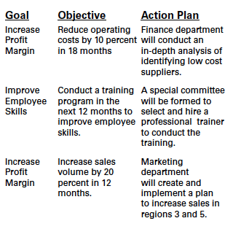

Actions Plans within the context of goals and objectives
Examples of action plans within the context :

Slide 15
Vision, Mission, …
Examples of strategies, goals, objectives and action plans are shown for a business organization designed to improve the rural economy through developing rural businesses.
Remember, the vision is what you want to accomplish.
Mission is a general statement of how you will achieve your vision.
Strategies are a series of ways of using the mission to achieve the vision.
Goals are statements of what needs to be accomplished to implement the strategy.
Objectives are specific actions and timelines for achieving the goal.
Action plans are specific actions that need to be taken for reaching the milestones within the timeline of the objectives.

Slide 16
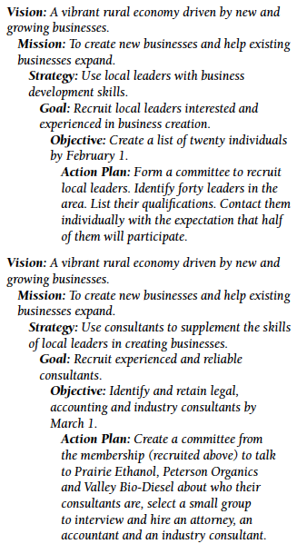
Example

Slide 17

Four Activities of the Strategic Mgmt Process
Review and Define the Organizational Mission
Analyze and Formulate Strategies
Set Objectives to Achieve Strategy
Implement Strategies Through Projects

Slide 18
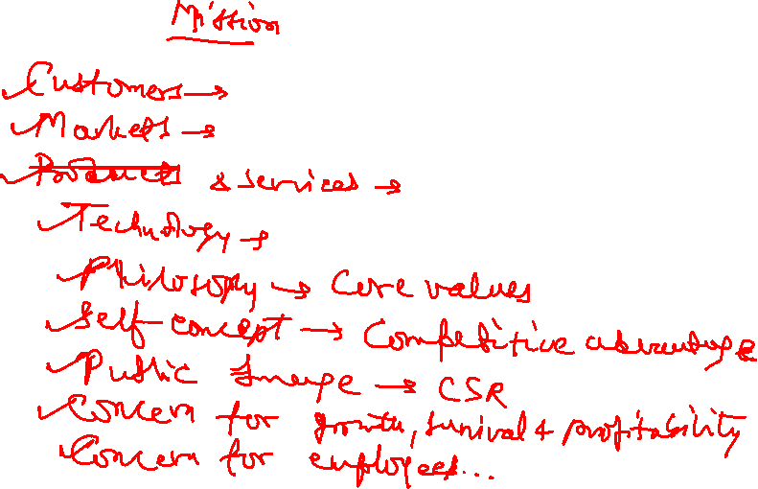

Slide 19
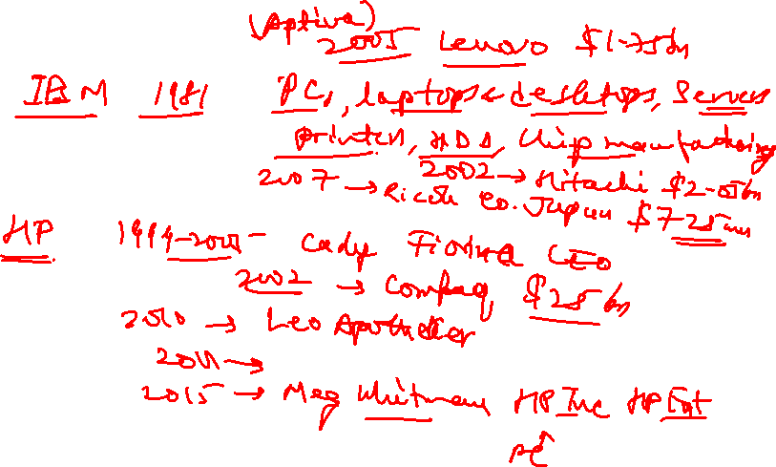

Slide 20

Review and Define the Organizational Mission
Mission Statements Identify the Scope of the Organization in Terms of its Product or Service.
The mission statement communicates and identifies the purpose of the Org’n to all stakeholders.
Traditional components found in MS’s are: major products and services, target customers and markets, and geographical domain.
Frequently include Organizational Philosophy, Key Technologies, Public Image and Contribution to Society.
Examples
Provide Cloud Computing Services
Provide Data Mining Services
Provide Information Technology Services
Increase Shareholder Value
Provide High-value Products to Our Customer.

Slide 21

Analyze and Formulate Strategies
What needs to be done to reach objectives.
SF includes determining and evaluating alternatives that support the Orgn’s objectives and selecting the best alternative.
The first step is an evaluation of the past and current position of the enterprise – an analysis of who are the customers and what are their needs as they see them.
The next step is an assessment of the Internal and External Environments.
SWOT Analysis
Formulating strategy might range around 20 percent of management’s effort.

Slide 22
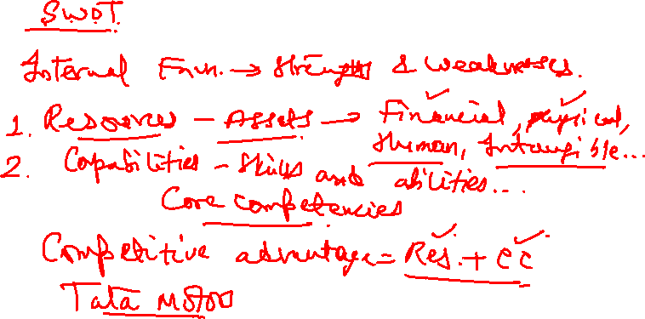
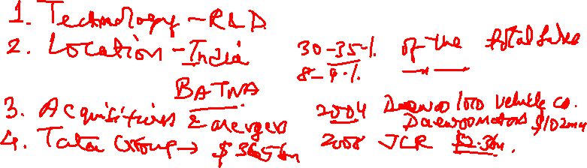

Slide 23
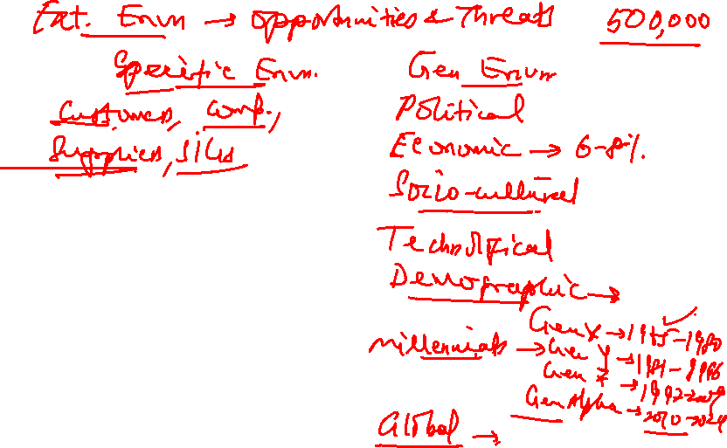

Slide 24

Set Objectives to Achieve Strategies
Objectives Translate Org’n Strategy into Specific, Concrete, Measurable Terms
Typically, Objectives Cover Markets, Products, Innovation, Productivity, Quality, Finance, Profitability, Employees and Consumers
Objectives should be as operational as possible, i.e. objectives should include a time frame, be measurable, be in an identifiable state, and be realistic.
SMART Goals (Specific, Measurable, Assignable, Realistic and Time Bound)

Slide 25

SMART (Objectives)
Specific : Be Specific in Targeting an Objective
Measurable: Establish a Measurable Indicator of Progress
Assignable: Make the Objective Assignable to One Person for Completion
Realistic: State What can Realistically be Done with Available Resources
Time Related: State When the Objective can be Achieved

Slide 26

Implement Strategies through Projects
Implementation Requires Action and Completing Tasks:
First, completing tasks requires allocation of resources: Funds, People, Technological Skills, Management Talents And Equipment. Multiple objectives place conflicting demands on resources.
Second, implementation requires a Formal and Informal Organization that Complements and Supports Strategy and Projects.
Third, Planning and Control Systems must be in place.
Fourth, Motivating Project Contributors.
Finally, portfolio mgmt and prioritizing projects.

Slide 27
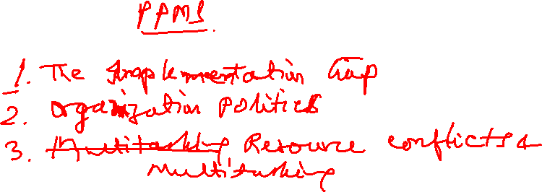

Slide 28
THE NEED FOR A PROJECT PORTFOLIO MANAGEMENT SYSTEM
1. THE IMPLEMENTATION GAP
  Conflicts Frequently Occur Amongst Functional Managers And Cause Lack Of Trust
  Frequent Meetings Are Called To Establish Or Re-negotiate Priorities
  People Frequently Shift From One Project To Another
  People Are Working On Multiple Projects And Feel In-efficient
  Resources Are Not Adequate

Slide 29
THE NEED FOR A PROJECT PORTFOLIO MANAGEMENT SYSTEM
2. ORGANIZATION POLITICS
Politics can influence which projects receive funding and high priority
Project Selection may not be on Facts and Sound Reasoning but on Persuasiveness and Power of People Advocating Projects
Sacred Cow Project: Project that a powerful, high ranking official advocates
New Baby: Irrational Obsession with a Project
Project Sponsors’ Role
Top Management should develop a System for Identifying and Selecting Projects that Reduce the Impact of Internal Politics and Fosters the Selection of the Best Projects

Slide 30
THE NEED FOR A PROJECT PORTFOLIO MANAGEMENT SYSTEM
3. RESOURCE CONFLICTS AND MULTI-TASKING
Problem of Sharing and Scheduling Resources across Projects
Multitasking Involves Starting and Stopping Work on one Task to go and work on another Project and then Return to work on the Original Task
Less Efficient People

Slide 31

Benefits of Project Portfolio Mgmt
Builds Discipline into Project Selection Process
Links Project Selection to Strategic Metrics
Prioritizes Project Proposals across a common set of criteria, rather than on politics or emotion
Allocates Resources to Projects that Align with Strategic Direction
Balances Risk across all Projects
Improves Communication and supports Agreement on Project Goals
Justifies killing Projects that do not support Organization Strategy

Slide 32
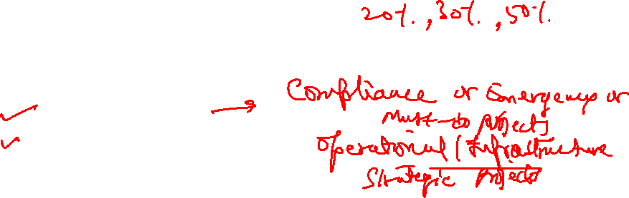
A PORTFOLIO MANAGEMENT SYSTEM
The aim of portfolio mgmt is to ensure that Projects are aligned with Strategic Goals and prioritized appropriately.
Since projects vying for funding and personnel usually outnumber available resources, it is imp to follow a logical and defined process for selecting the projects to implement.
Design of a Portfolio Management System should include:
  Classification of a Project
  Selection Criteria
  Sources of Proposals
  Evaluating Proposals
  Managing the Portfolio of Projects

Slide 33

CLASSIFICATION OF THE PROJECT
  COMPLIANCE or EMERGENCY: “MUST DO PROJECTS” TO MEET REGULATORY CONDITIONS REQUIRED TO OPERATE IN A REGION
  OPERATIONAL / Infrastructure: TO SUPPORT CURRENT OPERATIONS e.g. REDUCE DOWNTIME, IMPROVE EFFICIENCY, ENHANCE QUALITY ETC.
  STRATEGIC: DIRECTLY SUPPORT LONG RUN MISSION e.g. NEW PRODUCT, RESEARCH & DEVELOPMENT PROJECTS ETC.

Slide 34
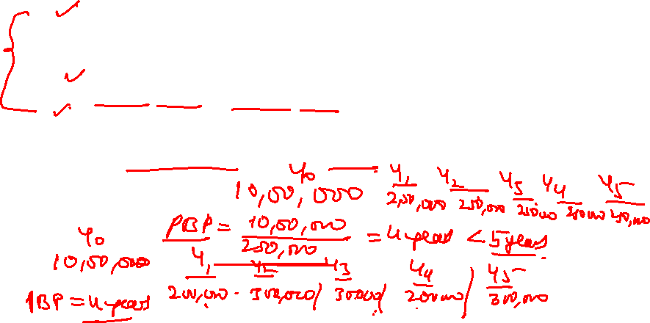

CRITERIA FOR PROJECT SELECTION
Financial Models: Preferred Method To Evaluate Projects
  PAY BACK PERIOD (in Years) : ESTIMATED PROJECT COST / ANNUAL SAVINGS
  RETURN ON INVESTMENT (in %)
  NET PRESENT VALUE (NPV) : Uses Time Value of Money, Cash Flows and Profitability

Slide 35
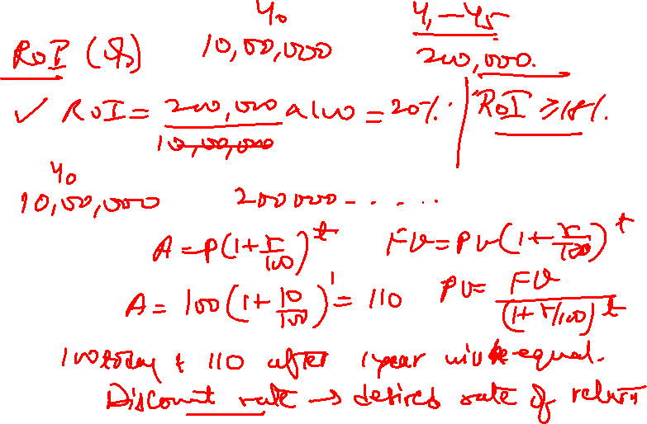

Slide 36
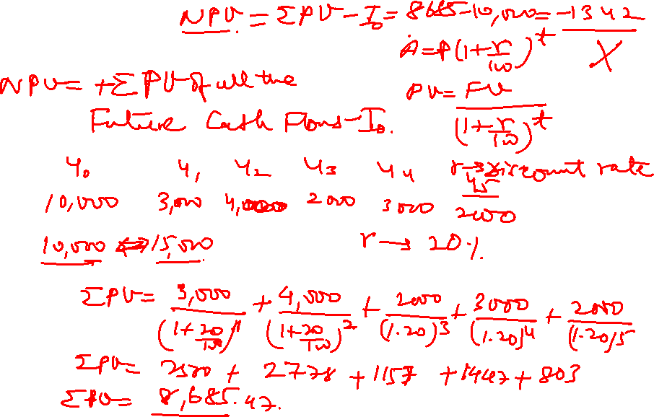

Slide 37
L3 - Project Management
Second Semester 2024-25 (S2-24)
Thank You!
M K Hamirwasia
hamirwasiamk@pilani.bits-pilani.ac.in

